Slide 1
Midterm Presentation
INFO-C451 – Logan Young
LMS Implementation

Slide 2
Development and Planning
System must be fully constructed and implemented
Development methodology used is the spiral model – iteration.
A plan must be made for all aspects of the implementation phase.

Slide 3
Risk Assessment
Several large and small risks that could occur during implementation
Employee quits, funds run out, project files are lost, etc.

Slide 4
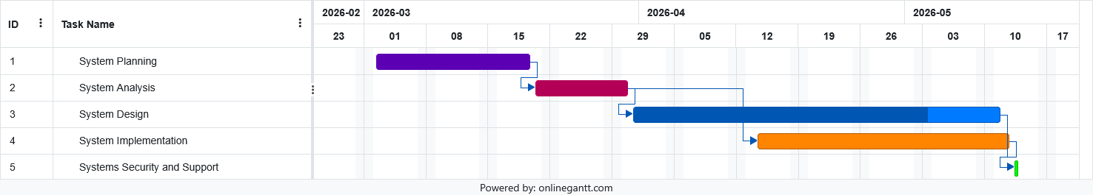
Timeline and Installation
The entire project will take about two and a half month up to systems support. Implementation will take about three weeks.
Parallel operation: preserve old system while new system is in operation.
System has to be built, tested, and deployed.

Slide 5
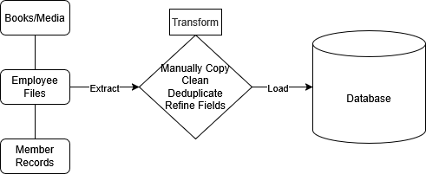
Data Migration
Data will be migrated from a physical system to a digital one.

Slide 6
Test Plan and Cases
Unit, integration, system, and acceptance testing.
Test functions, scripts, their connections, then everything.
Test Case ID | Description | Precondition | Input | Expected Output
TC-F-011 | Member attempts to check out a book that is not available. | User account is member level or higher and chosen book is not available. | Book: Animal Farm [Checked Out] | Book checkout fails, “This book is [Checked Out], please submit a hold request or choose another book!”
TC-V-004 | Email does not comply with regex email check. | User has entered an incorrect email address into the email field. | Email: lmsuser1.com | Account creation disabled, email field warning, “Email is invalid! Please check to make sure email is formatted correctly.”

Slide 7
System Debugging and Testing
Debugging will be handled in IDE.
Large, functional bugs will need to be handled before deployment.
Small bugs that don’t impact usability handled after.
Few, if any, automated testing tools required. Postman.

Slide 8
Data Conversion and Testing
Physical records converted to digital ones.
Copied, cleaned, deduplicated, reorganized.
Validation, outside research to fill empty fields.

Slide 9
System Implementation Plan Summary
System software construction from logical and physical models.
Hardware construction.
Software and hardware connection.
Data cleaning and copying.
System and data testing and validation.
System deployment and user testing.

Slide 10
Success Factors and Lessons Learned
Meet all needs set in project plan + extra requirements given by client.
User testing continues and goes well.
System is supported and secure for length of contract.
Lessons learned added to development team knowledge.

